Slide 1
Generations and
Demographic Dividends
Turro Wongkaren & Diana Stojanovic
Lembaga Demografi
Faculty of Economics and Business
Universitas Indonesia
Presented at the Global Virtual Meeting on Population and the Generational Economy, August 3-7, 2020
This research is funded by the Bank Indonesia Institute Research Grant 2019

Slide 2
Motivation
Generations will affect the economy through their
Size
Behavioral characteristics
Each generation has their own characteristics
Consumption
Savings
Working ethics
…
Researches often use classification based on the American experiences
(‘Boomer classification’)
Generations (Pew 2018)
Period | Name
1946-1964 | Baby Boomers
1965-1980 | Generation X
1981-1996 | Millennials
1997 - … | Post Millennials

Slide 3
Research questions
Do generations based on the American classification fit the Indonesian context and experiences?
If not, how do we classify cohorts into generations in Indonesia?
What is the effect of using generational values on demographic dividends?

Slide 4
Data
National Social-economic Survey (Susenas) 1995-2018
National Labor Force Survey (Sakernas), 2000-2018
Economic & labor variables
labor force participation rate
percentage of entrepreneurs
percentage of agricultural worker/sector
percentage of home ownership
Demographic variables
age of first marriage for woman
number of children per mother
percentage of living in an extended family
traveling
Social variables
Being a victim of a crime
school participation rate

Slide 5
Methods
Regression
$$Y_{t}=α+ {Age}_{t}+ {year_born}_{t} + {GDPcapita}_{t}+ ε$$
… to calculate age-specific profiles for each cohort
Use of similarity measures and grouping
… to classify cohorts into generations

Slide 6
Example: Proportion of entrepreneurs by age and cohort
At age 25, the percentage for those who were born in 1978 was close to 20%, but the number was only 12% for those who were born in 1993

Slide 7
How similar are two cohorts?
We can compare:
average values, extrema, cumulative level differences, shapes
Issue when comparing profile-based differences:
Only partial age-overlaps between cohort profiles (survey availability)
Less overlap for certain pairs of cohorts
=> Normalize (per overlapping point)

Slide 8
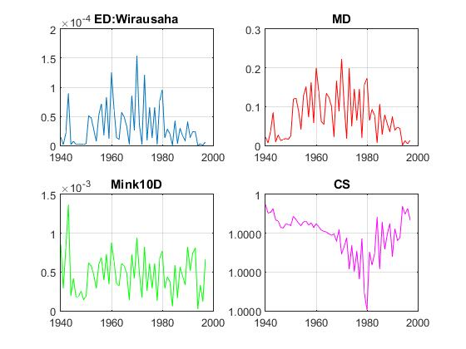
Some distance measures for Entrepreneurship
Measures reflect differences between two consecutive cohorts
A peak in distance or a dip in similarity signals a change: potential start of a new generation

Slide 9
Combining changes in several variables
New generation
defined by several closely occurring changes
(time band of 3-5 years)

Slide 10
Results
Cohort | Characteristic
1948-1969 | higher LFPR, travel more, higher age of 1st marriage, crime | Orde Lama Old-order Generation
1970-1990 | even higher age of 1st marriage, fewer children, lower entrepreneurship | Orde Baru New-order Generation
1991-2000 | higher school enrollment, fewer owned house | Reformasi
2001 - … | even higher school enrollment, higher LFPR, travel more | Post Reformasi
The periodization of the generations in Indonesia seem to resemble that of political periods
We tested against survey data, the results show that this classification has lower Coefficient of Variations than the classification based on ‘boomers classification’

Slide 11
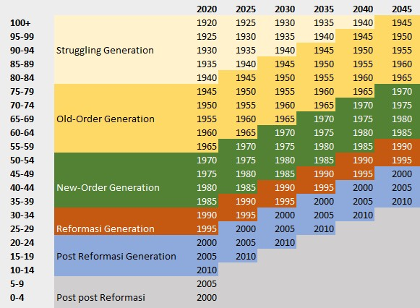
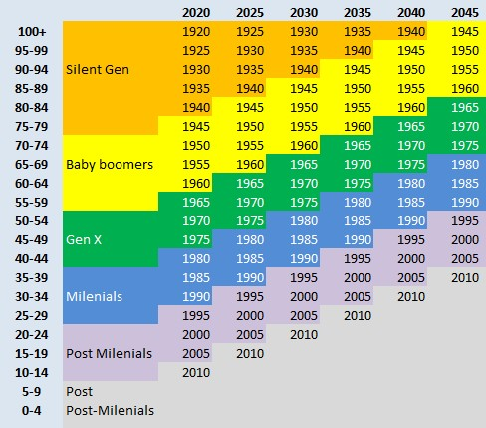
Comparison of Indonesian generations using different classification
Indonesian classification
‘American’ classification

Slide 12
Proportion of population of each generation using different classifications
Indonesian | 2020 | 2045
Old-Order | 0.22 | 0.05
New Order | 0.32 | 0.21
Reformasi | 0.17 | 0.13
Post Reformasi | 0.26 | 0.61
American | 2020 | 2045
Baby boom | 0.16 | 0.02
Gen X | 0.20 | 0.14
Milennial | 0.24 | 0.18
Post | 0.41 | 0.68

Slide 13
Effect on Demographic Dividends
Questions:
Does separating population into generations affect demographic dividends?
Specifically, will it affect the duration and the end-year of the demographic dividends?

Slide 14
First and Second Demographic Dividend using 2018 economic life-cycle
Indonesia
Using the conventional NTA method, Indonesia will end its 1st dividend in 2025, and only starts to enjoy the 2nd dividend in 2040

Slide 15
Acommodating generations

Slide 16
Introducing synthetic age profiles
Proportion labor income to consumption increases over time
- Peak of labor income moves to the right , old-age LFPR decreases
2018 age profiles

Slide 17
Using different age-profiles for different cohorts
Born up
to 1990
synthetic age profile
c.1991 and beyond
2018 age profile

Slide 18
First and Second Demographic Dividends using Synthetic and 2018 economic life-cycle
Indonesia
Using different age-profiles for different generations would push the 1st dividend to 2028 (compared to 2025)
The 2nd dividend will start earlier, in 2029 (compared to 2040)
*blue curve off scale

Slide 19
Conclusions
Conclusion
Future Work
Generational classifications may vary across countries, not necessarily following that of the US
Different generations may bring different preference and experience, reflected in age-profiles
The dividend periods recognizing different generations may be longer than suggested by the conventional measures
Finding the behaviors that may affect the consumptions and labor income profiles
Using more than two generations

Slide 20
We will be happy to hear your questions and comments
Mahalo!
Turro: twongkaren@gmail.com
Diana: dswongkaren@gmail.com

Slide 21
Some Distance Measures we considered
(squared) Euclidean Distance
$\sqrt{\sum_{k=1}^{n}{{(A_{k}−B_{k})}^{2}}}$
Manhattan Distance
$\sum_{k=1}^{n}{|A_{k}−B_{k}}|$
Minkowski Distance
$\sqrt[λ]{\sum_{k=1}^{n}{{(A_{k}−B_{k})}^{λ}}}$
Cosine Similarity
$\sum_{k=1}^{n}{A_{k}B_{k}}$/
----------------------------------- $\sqrt{\sum_{k=1}^{n}{{(A_{k})}^{2}}}\sqrt{\sum_{k=1}^{n}{{(B_{k})}^{2}}}$

